Slide 1

Introduction to algorithms
Seminar 1
w/c: 27 September 2021

Slide 2
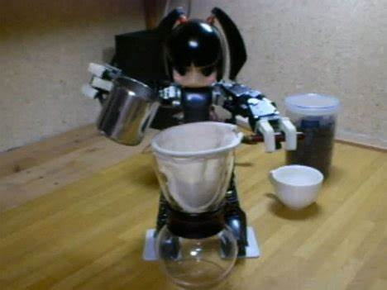
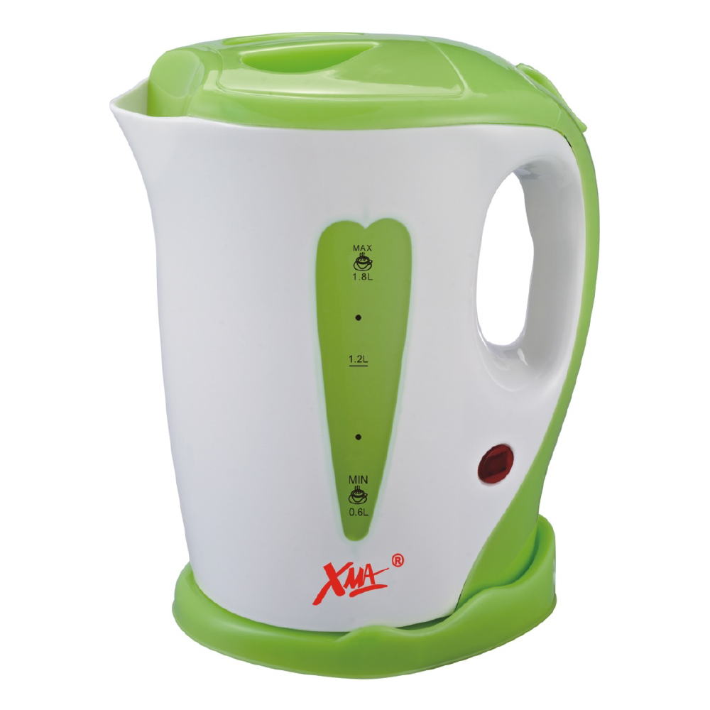





Program your robot to make you coffee every morning!!
Robot can only execute elementary actions:
switch on
pick up
drop
pour
stir
repeat
on/off
Robot cannot multitask; only performs one task at a time!
Robot can measure time and weight and count
electric jug
mug
coffee
sugar
milk
teaspoon

Slide 3


Program your robot to make you coffee every morning!!
switch on
pick up
drop
pour
stir
repeat
on/off
Algorithm
01. Switch on the electric jug.
02. If the red light is off
03. Pick 5 grams of coffee
04. Pour coffee in the mug
$$×$$
05. Pick up 1 sugar cube
06. Drop sugar cube in mug
07. Repeat step 05
08. Repeat step 06
09. Pick up teaspoon
10. Pick 1 teaspoon of milk
11. Pour milk in mug
12. Repeat step 10
17. Pour 200ml of water in mug
13. Repeat step 11
18. Repeat step 09
14. Repeat step 10
19. Stir in mug for 10 secs
15. Repeat step 11
20. END
16. Pick up electric jug

Slide 4
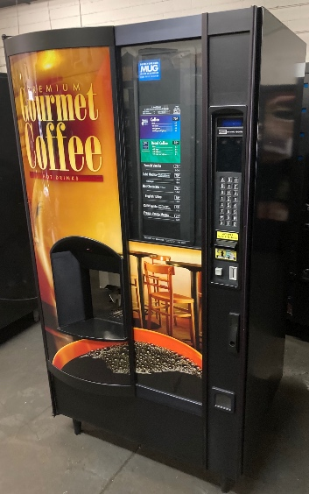
Program your robot to make you coffee every morning!!
switch on
pick up
drop
pour
stir
repeat
on/off
Algorithm
Would you go through
the same amount of detail
if you were giving these instructions
to a human??
01. Switch on the electric jug.
02. If the red light is off
03. Pick 5 grams of coffee
04. Pour coffee in the mug
$$×$$
05. Pick up 1 sugar cube
06. Drop sugar cube in mug
We humans have common sense!!
07. Repeat step 05
08. Repeat step 06
09. Pick up teaspoon
A robot/computer/machine
does not possess common sense.
Every action needs to be broken down
into smaller (elementary) actions;
hence lots of steps/detail.
10. Pick 1 teaspoon of milk
11. Pour milk in mug
12. Repeat step 10
17. Pour 200ml of water in mug
13. Repeat step 11
18. Repeat step 09
14. Repeat step 10
19. Stir in mug for 10 secs
15. Repeat step 11
20. END
16. Pick up electric jug

Slide 5


Coins and balance problems
For this kind of problems; is binary division always the quickest??
12
$$×$$
6
6
1
$$×$$
3
3
2
1
1
1
3

Slide 6


Coins and balance problems
For this kind of problems; is binary division always the quickest??
24
$$×$$
12
12
1
.
.
.
.
$$+$$
3

Slide 7





Coins and balance problems
For this kind of problems; is binary division always the quickest??
24
$$×$$
$$×$$
8
8
1
8
$$×$$
$$×$$
3
3
2
2
$$×$$
1
1
3

Slide 8




Coins and balance problems
For this kind of problems; is binary division always the quickest??
24
$$×$$
$$×$$
8
8
1
8
$$×$$
$$×$$
3
3
2
2
$$×$$
$$×$$
1
1
1
3

Slide 9
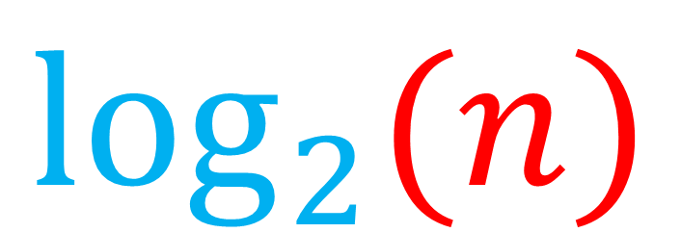

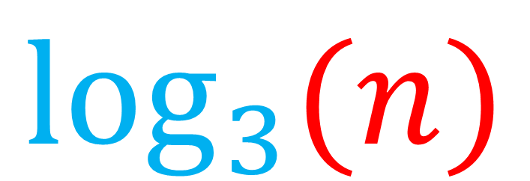
Coins and balance problems
How many steps required for $n$ coins?
Binary Division
3-way Division
$$\log_{2}{(n)}$$
$$\log_{3}{(n)}$$

Slide 10
Linear search – binary search
sorted list
1 | 3 | 7 | 11 | 14 | 16 | 19 | 21 | 22 | 26
unsorted list
10 | 3 | 17 | 11 | 14 | 6 | 9 | 2 | 0 | 26
Searching:
the process of finding and retrieving an element from a dataset
Would you prefer to search through a sorted list or unsorted list?

Slide 11
Linear search
unsorted list
10 | 3 | 17 | 11 | 14 | 6 | 9 | 2 | 0 | 26
Search for x=6
x=10 ?
x=3 ?
x=17 ?
x=11 ?
x=14 ?
x=6 ?
Compare element-wise until success!!
10 | 3 | 17 | 11 | 14 | 6 | 9 | 2 | 0 | 26
NO!
NO!
NO!
NO!
NO!
YES!
Worst-case scenario:
Search for x=26
O(N)
Worst-case scenario for a list of length N:
Must perform N comparisons

Slide 12
Binary search (sorted list)
divide & conquer
1 | 3 | 7 | 11 | 14 | 16 | 19 | 21 | 22 | 26
Search for x=11
Find the middle of list:
Is x = 14?
NO
Is x > 14?
NO
Keep the left half of the list because x<14 and the list is sorted.
1 | 3 | 7 | 11 | 14
Find the middle of list:
Is x = 7?
NO
Is x > 7?
YES
Keep the right half of the list
7 | 11 | 14
Find the middle of list:
Is x = 11?
YES
√

Slide 13
Binary search performance
O(lg(N))
Worst-case scenario for a list of length N:
Must perform lg(N) comparisons
On average comparing worst-case scenarios, binary search is faster than linear search
lg(N) < N
Binary search is faster because it requires less work! But it only works on sorted lists!!

